Slide 1
Guess the Song
From Emojis

Slide 2
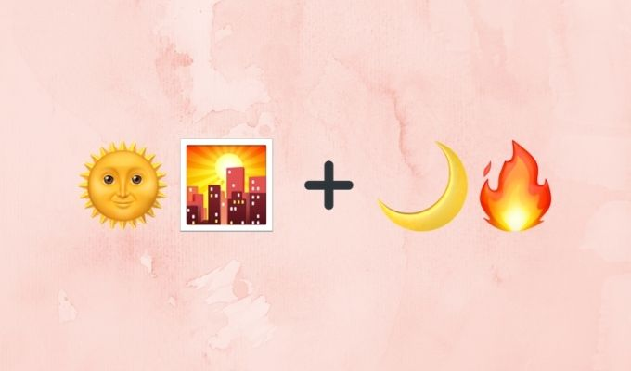

Slide 3
Sooraj Hua maddham, chand Jalne laga

Slide 4
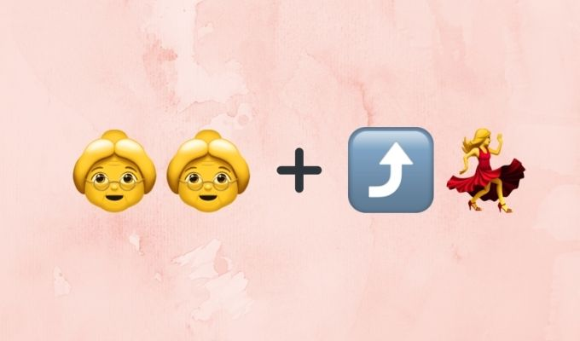

Slide 5
Aunty Ji , Aunty Ji Get Up and Dance

Slide 6
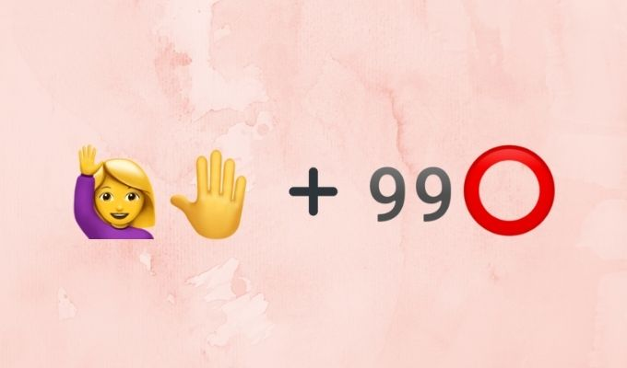

Slide 7
Mere haathon main No no chudiyan hai

Slide 8
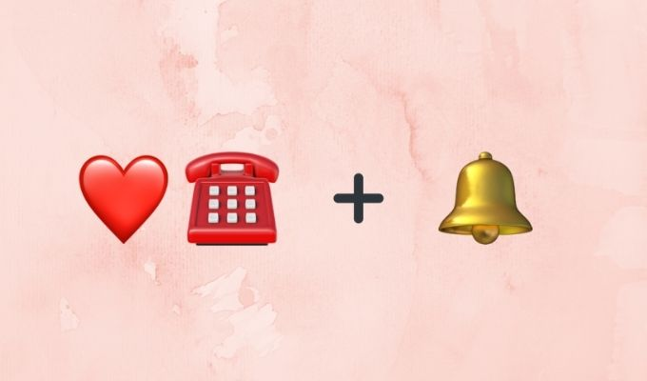

Slide 9
Dil ka telephone bajta ring ring rara ring

Slide 10
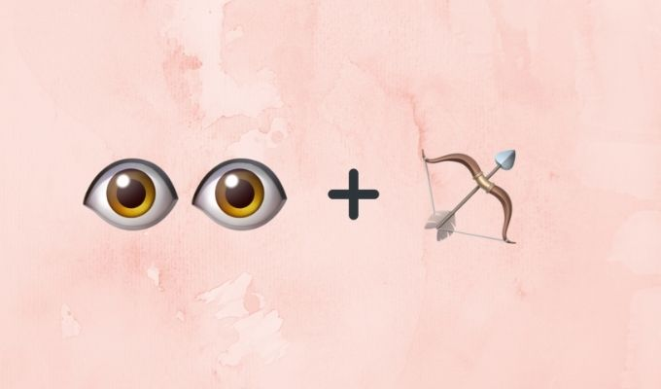
Chalao na naino se baan re

Slide 11
Guess the Movie
From Emojis

Slide 12


Slide 13
NAMASTE ENGLAND

Slide 14
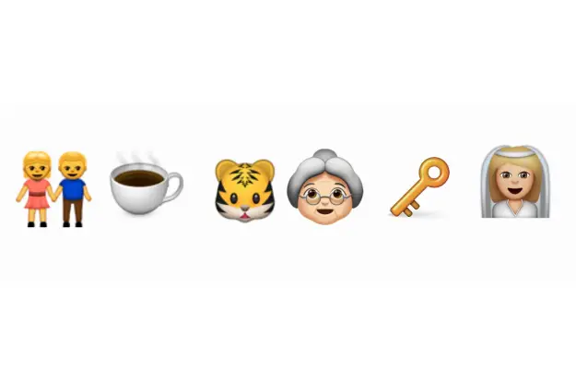

Slide 15
HUMPTY SHARMA KI DULHANIYA

Slide 16


Slide 17
STUDENT OF THE YEAR

Slide 18


Slide 19
HOUSEFULL

Slide 20


Slide 21
DIL DHADAKNE DO

Slide 22
KYA AAP 5WI PAAS SE TEZZ HAI???

Slide 23
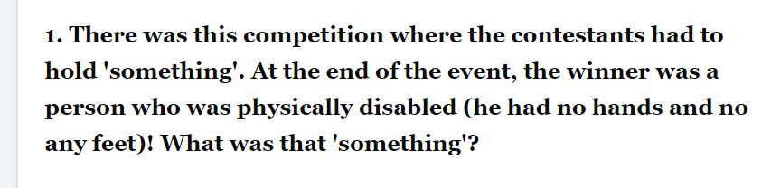

Slide 24
BREATH

Slide 25
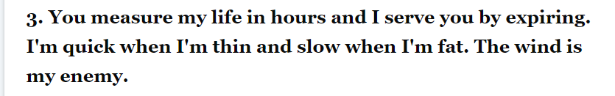

Slide 26
A CANDLE

Slide 28


Slide 29


Slide 30


Slide 32


Slide 33
LETS TICKLE YOUR BRAIN FOR SOME MORE TIME

Slide 35


Slide 36
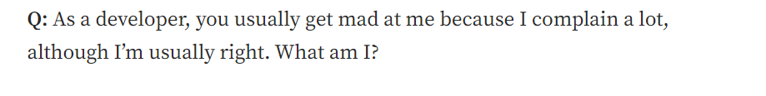

Slide 37
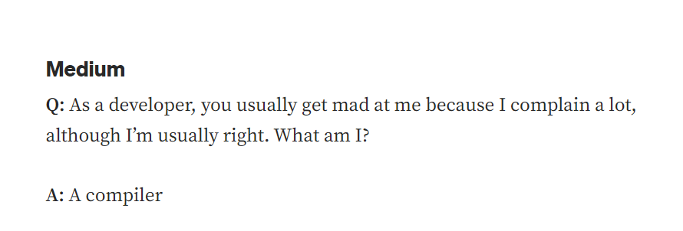

Slide 38
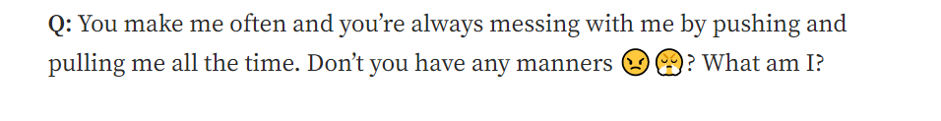

Slide 39
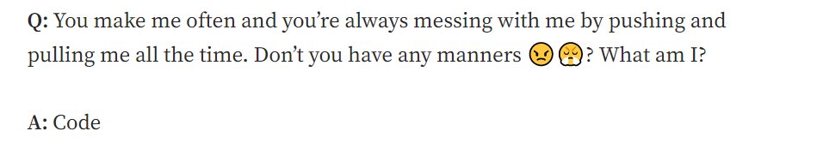

Slide 40
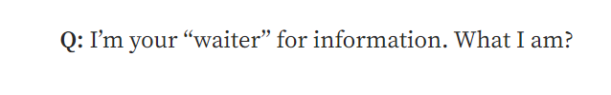

Slide 41
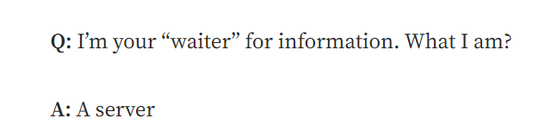

Slide 42
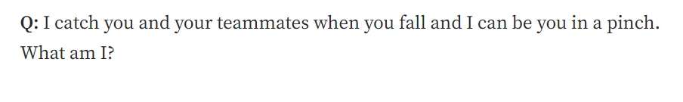

Slide 43
